Slide 1

Basics of Neural Network Programming
Logistic Regression
Gradient descent
deeplearning.ai
Notes:
1

Slide 2
Basics of Neural Network Programming
Gradient descent
on m examples
deeplearning.ai
Notes:
1

Slide 3

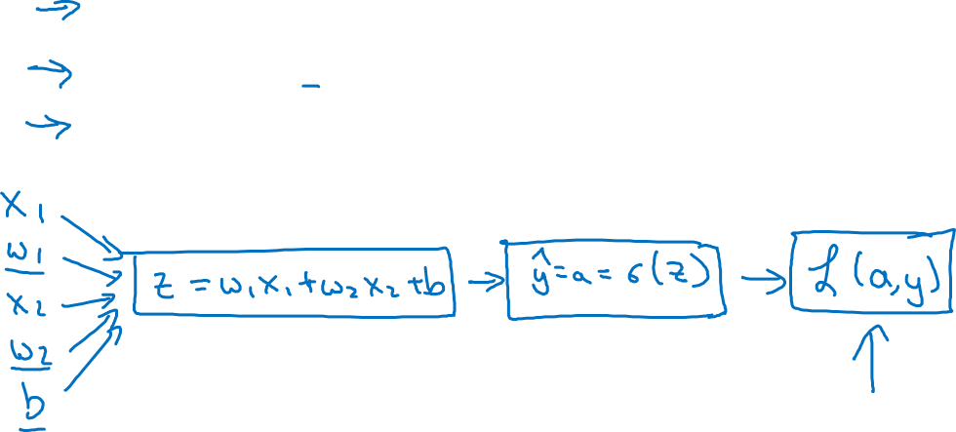

Logistic regression recap

Slide 4


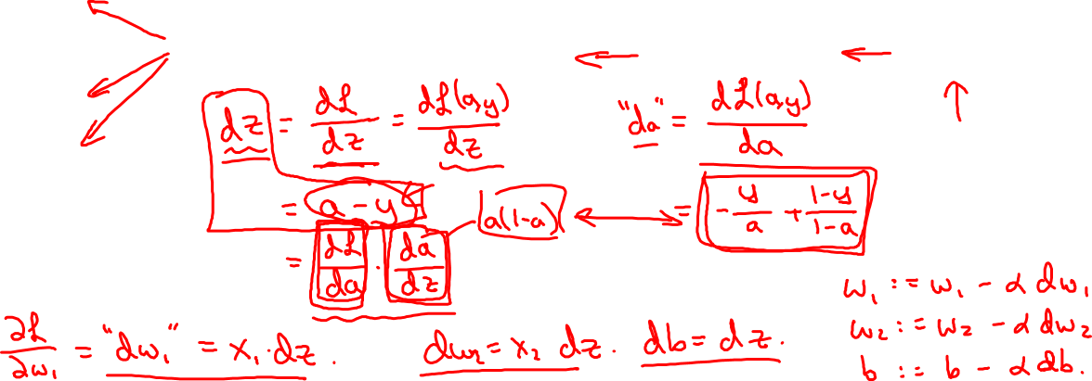





Logistic regression derivatives
b

Slide 5
Basics of Neural Network Programming
Gradient descent
on m examples
deeplearning.ai
Notes:
1

Slide 6
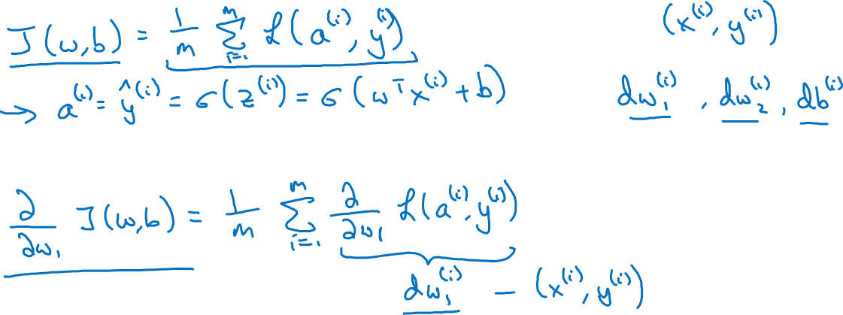
Logistic regression on m examples

Slide 7
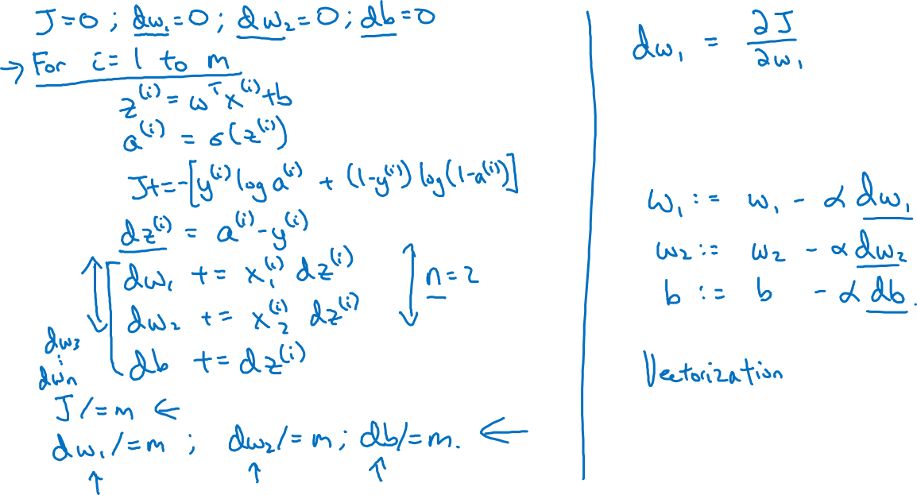
Logistic regression on m examples

